Slide 1



Slide 2

Making the Text Talk
Frank Ray Conference Teaching Plan
Day ❶ = Thinking Holistically as an
Expository Preacher
Day ❷ = Thinking Hermeneutically for
Expository Preaching
Day ❸ = Thinking Homiletically towards
Expository Preaching
Pastor Reginald D. Taylor 901-258-2876
reginaldtaylorministries@gmail.com

Slide 3
Making the Text Talk
Frank Ray Conference Teaching Plan
Day ❶ = Devotional
Day ❷ = Technical
Day ❸ = Practical
Pastor Reginald D. Taylor 901-258-2876
reginaldtaylorministries@gmail.com

Slide 4
Making the Text Talk
Frank Ray Conference Teaching Plan
Day ❶ = Some Foundations for Exposition
Day ❷ = Some Functions for Exposition
Day ❸ = Some Flows for Exposition
Pastor Reginald D. Taylor 901-258-2876
reginaldtaylorministries@gmail.com

Slide 5
Making the Text Talk
Frank Ray Conference Teaching Plan
Day ❶ = Our Posture—the Heart
Day ❷ = Our Preparation—the Habits
Day ❸ = Our Preaching—the Heralding
Pastor Reginald D. Taylor 901-258-2876
reginaldtaylorministries@gmail.com

Slide 6

Thinking Holistically
The Preparation of the Preacher
His Soul
His Service &
His Sermons
Pastor Reginald D. Taylor, Instructor
901-258-2876
reginaldtaylorministries@gmail.com

Slide 7

  Ezra 7:10 (KJV)
  ¹⁰ For Ezra had prepared his heart to seek the law of the LORD, and to do it, and to teach in Israel statutes and judgments.
  DECIDE to PURSUE the WORD
  DETERMINE to PERUSE the WORD
  DEVOTE to PRACTICING the WORD
  DEDICATE to PROCLAIMING the WORD

Slide 8
  Ezra 7:10 (KJV)
  ¹⁰ For Ezra had prepared his heart to seek the law of the LORD, and to do it, and to teach in Israel statutes and judgments.
  Ezra’s MOTIVATION
  Ezra’s MANUAL
  Ezra’s MATURITY
  Ezra’s MINISTRY

Slide 9
Great Commitments = A Great Preaching Ministry
Devotional Thoughts
The Great Commandment: Matt. 22:35-40
The Great Commission: Matt. 28:18-20
The Great Compassion: John 13:34-35
The Great Community: Acts 2:42-47
The Great Contribution: Matt. 25:31-46

Slide 10


“A text-driven sermon is a sermon that develops a text by explaining, illustrating, and applying its meaning. Text-driven preaching stays true to the substance of the text, the structure of the text, and the spirit of the text.”
–Text-Driven Preaching, B&H Academic, 2010
2 Timothy 2:15
  Be Studious in the Catalogue
  Be Stable in the Connection
  Be Steadfast in the Commission
  Be Standardized in the Communication

Slide 11
The Preacher & His Soul
Be Going to the WORD (2 Tim. 3:16-17)
Be Gaining from the WORD (Col. 1:9-14)
Be Governed by the WORD (Deut. 6:4-9)
Be Given to the WORD (Joshua 1:7-8)
Be Guided by the WORD (Ps. 1:1-3)
Be Groomed by the WORD (Ps. 119:9-18)
Be Grounded in the WORD (Col. 3:16-17)
Be Grappling with the WORD (Ezra 7:10)
Be Graced by the WORD (Ps. 19:7-11)
Be Growing through the WORD (I. Pet. 2:2)
Be Grinding in the WORD (2 Pet. 1:3-8)

Slide 12
The Preacher & His Soul
 Praying Continually (I. Thess. 5:16-17; 1 Chr. 16:11)
 Reading Scripture & Journaling Daily (Jn. 5:39; 2 Tim. 3:16-17)
 Memorizing Scripture Weekly (Joshua 1:8; Ps. 119:11)
 Relying on the Spirit Consistently (John 14:26; 16:13)

Slide 13
The Preacher & His Soul
RELATING = Ask God to Meet You in Scripture (Ps. 119:17-19)
REPENTING = Read the Bible with a Repentant Heart (Ps. 119:133)
RUMINATING = Meditate on a Fairly Brief Passage or Narrative (Ps. 119:9-16; Phil. 4:8)
REFLECTING = Take One Thought or Verse with You Through the Day (Ps. 1:1-3)
REMEMBERING = Allow This Thought to Become Part of Your Memory (Col. 3:16-17)

Slide 14
The Preacher & His Soul
Be Grinding in the WORD: 2. Pet. 1:3-8
  Some Growth-Plans: Ps. 119:9-16,105,133
  Some Growth-Practices: 2 Tim. 2:15
  Some Growth-Prayers: Col. 1:9-14
  Some Growth-Partners: Ps. 119:63-64
  Some Growth-Places: Acts 2:42-47

Slide 15

The Preacher & His Service
Reproducing Disciple-Making Disciples—Matt. 28:18-20
Raising Up Leaders—2 Tim. 2:1-6,15
Redemptive-Living—Matt. 25:31-46

Slide 16

The Preacher & His Sermons
Three Kinds of Sermons
  Sermons that Build-Up—Col. 1:28-29; 2:6-7
  Sermons that Fire-Up—Ps. 103:1-14; Heb. 12:1-2
  Sermons that Hold-Up—Gal. 6:1-2; 1 John 2:1-2

Slide 17
The Preacher & His Sermons
Three Goals of Preaching
  Edify/Equip—Eph. 4:11-16
  Exhort—2 Tim. 3:16-4:2
  Encourage—Romans 15:4

Slide 18
The Preacher & His Sermons
Three Sermonic-Aspects
  Sermonic-Targets—Mark 5:1-20; John 4:4-42
  Sermonic-Types—Mk 16:15-16; Rom. 10:17; Col. 3:16-17
  Sermonic-Teaching—Heb. 10:38-11:40
Lessons for Living
Characters Study through Genesis

Slide 19
The Preacher & His Sermons
Four Benefits of Expository preaching
  Increasingly Knowing—Col. 1:9-10
  Increasingly Growing—1 Pet. 2:2
  Increasingly Flowing—John 15:5-8
  Increasingly Sowing—Gal. 6:6-10

Slide 20
The Preacher & His Sermons
  Colossians 1:9-14
  Your Prayer Life (v.9)
  Your Preparation (v.9b)
  Your Practice (v.10a)
  Your Priorities (v.10b)
  Your Productiveness (v.10c)
  Your Protection (v.10d)
  Your Praise (v.12-14)

Slide 21

The Preacher & His Sermons
Is. 55:11
All preaching must be expository, in the strict sense that we must bring out of Scripture what God by his Spirit has breathed into scripture.

Slide 22
The Preacher & His Sermons
The Disciplines of the Expository Preacher
Devotional-Time: Mark 1:35; Ps. 19:7-11
Developmental-Time: 2 Tim. 2:15
Discovery-Time: Col. 3:16-17
Devising-Time: I. Pet. 4:10-11
Delivery-Time: Mark 5:1-20

Slide 23
The Preacher & His Sermons
Various Approaches to Expository Preaching
Verse-by-Verse: Book of Ephesians
Topical: Gospel of John
Doctrinal/Thematic: Book of Romans
Narrative: Gen. 37-50 (Joseph); Acts 7 (Stephen)
Biographical: Gen. 12-25 (Abraham) etc.
Typological: Christ in the Book of Hebrews*

Slide 24

Joshua 1:8
Expository preaching is the art of preaching a series of sermons, either consecutive or selective, from a Bible book

Slide 25
The Preacher & His Sermons
Various Approaches to Expository Preaching
Information: Background
Explanation: “Original-Authorial-Intent”
Illustrations: “To Cast Light Upon”
Applications: “from THEN to NOW”
Correlations: Scripture-verifying-Scripture
Implications: Life-Change by grace, through faith

Slide 26
Dr. Jeffrey Campbell
Expository preaching is a philosophy of preaching that explains, illustrates and applies the text of Scripture. True exposition occurs when a preachable unit of Scripture is examined according to its historical, grammatical and literary contexts, and then a sermon is presented whose substance and structure are governed by the substance and structure of the text being preached. The preacher and hearers are exposed to the revelation of God through Scripture and the power of God through the Holy Spirit with life transformation being the goal.
Ps. 119:9-16

Slide 27
The Preacher & His Sermons
Areas to Consider
Corpus
Pull from the _______ of the Writer
Pull from the _________ of the Book
Pull from the _________ of the Passage
Pull from the _______________ of the Imperative(s)
Context
Content
Connotations

Slide 28
Aspects to Communicate
_______________ Clarification
_______________ Motivation
_______________ Operation
_______________ Demonstration
_______________ Transformation
Explanation
Exhortation
Application
Illustration
Invitation
The Preacher & His Sermons

Slide 29

Approaches to Crafting
Communicate the Doctrine(s)
Delineate the Duties
Elevate the Discipleship
Writing the Sermon ➔
The Preacher & His Sermons

Slide 30
Approaches to Crafting
Bones
The ____________
The ____________
The ____________
The ____________
The ____________
Writing the Sermon ➔
Body
Beginning
Back-End
Buy-In
The Preacher & His Sermons

Slide 31
The GOALS of Bible Study
Discovering the Word
⬇
Doing the Word
⬇
Delivering the Word
Moving from
Investigation to
Implementation
Investigation
⬇
Application
⬇
Communication
Moving from Exegesis
to Exposition
The Preacher & His Sermons

Slide 32
Developing a Rhythm of Sermon Preparation
An Ideal Week
Sunday: Contemplation + Compilation
Monday: Observations + Translations
Tuesday: Analyzations
Wednesday: Organization
Thursday: Dissertation + Publication
Friday: Saturation + Memorization
Saturday: Saturation + Memorization + Dedication
The Preacher & His Sermons

Slide 33
The Preacher & His Sermons
The Disciplines of the Expository Preacher
Every Week
Read Yourself Full: John 5:39
Write Yourself Clear: 2 Timothy 2:15c
Pray Yourself Hot: James 5:13-16
Preach Yourself Empty: Acts 20:25-28*

Slide 34
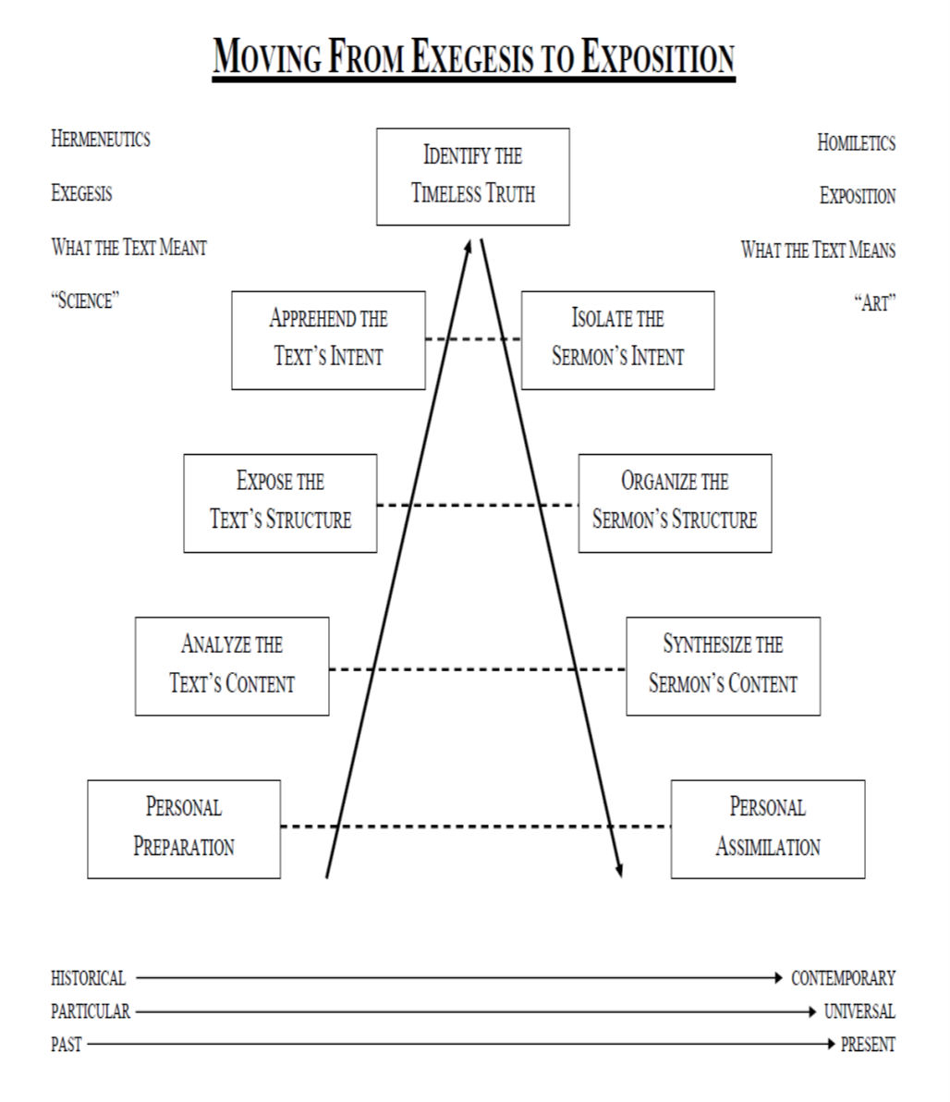

Slide 35
Exhortations for the Preacher
Preach the Word Conscientiously
Preach the Word Continuously
Preach the Word Comprehensively
Preach the Word Courageously

Slide 36
Parting Exhortation
Every Week
Read Yourself Full: John 5:39
Write Yourself Clear: 2 Timothy 2:15c
Pray Yourself Hot: James 5:13-16
Preach Yourself Empty: Acts 20:25-28*

Slide 37





$20 Separately and $60 as a Set
Homiletical & Devotional Resources
$ReginaldDTaylor

Slide 38

Spiritual Growth ResourceS
Spiritual Growth 101
Maintaining A Biblical Perspective During A Bad Pandemic
40 Sermons for $20
101 Sermons for $50
$ReginaldDTaylor

Slide 39



