Slide 1



Slide 2

Making the Text Talk
Frank Ray Conference Teaching Plan
Day ❶ = Thinking Holistically as an
Expository Preacher
Day ❷ = Thinking Hermeneutically for
Expository Preaching
Day ❸ = Thinking Homiletically towards
Expository Preaching
Pastor Reginald D. Taylor 901-258-2876
reginaldtaylorministries@gmail.com

Slide 3
Making the Text Talk
Frank Ray Conference Teaching Plan
Day ❶ = Some Foundations for Exposition
Day ❷ = Some Functions for Exposition
Day ❸ = Some Flows for Exposition
Pastor Reginald D. Taylor 901-258-2876
reginaldtaylorministries@gmail.com

Slide 4
Making the Text Talk
Frank Ray Conference Teaching Plan
Day ❶ = Our Posture—the Heart
Day ❷ = Our Preparation—the Habits
Day ❸ = Our Preaching—the Heralding
Pastor Reginald D. Taylor 901-258-2876
reginaldtaylorministries@gmail.com

Slide 5
Making the Text Talk
Frank Ray Conference Teaching Plan
Day ❶ = Devotional
Day ❷ = Technical
Day ❸ = Practical
Pastor Reginald D. Taylor 901-258-2876
reginaldtaylorministries@gmail.com

Slide 6

Thinking Homiletically
Designing & Delivering
Expository Sermons
Pastor Reginald D. Taylor, Instructor
901-258-2876
reginaldtaylorministries@gmail.com

Slide 7
Devotional Thoughts
  Joshua 1:8 (KJV)
  ⁸ This book of the law shall not depart out of thy mouth; but thou shalt meditate therein day and night, that thou mayest observe to do according to all that is written therein: for then thou shalt make thy way prosperous, and then thou shalt have good success.
Proclamation
Meditation
Observation
Application
Expectation

Slide 8
Devotional Thoughts
  Joshua 1:8 (KJV)
  ⁸ This book of the law shall not depart out of thy mouth; but thou shalt meditate therein day and night, that thou mayest observe to do according to all that is written therein: for then thou shalt make thy way prosperous, and then thou shalt have good success.
Reading
Reciting
Reflecting
Respecting
Responding
Receiving

Slide 9
What is Taylor Trying To Do?
Provide for You…
A Motivation for Exegesis
  (2 Tim. 2:15)
A Model of Exposition
  (2 Tim. 3:16-4:2)
A Mind-Set of Excellence
  (Matt. 4:1-11)
A Ministry of Evangelizing, Equipping, & Empowering
  (2 Tim. 2:1-2)
Notes:
Be Studious, Stable, Steadfast, & Standardized Outline
The Imperative to Study
The Importance of Study
The Implications of Study
2 Tim. 3:16-4:2 = The 7M’s
Matt. 4:1-11 = Worldview, Warfare, Worship
2 Tim. 2:1-2 = Scholarship for Discipleship

Slide 10

Word Study Driven Outline
Be Filled with the Word (v.9)
Be Faithful in our Walk (v.10a)
Be Focused on His Will (v.10b)
Be Fruitful in His Work (v.10c)
Be Furthered in our Witness (v.10d)
Be Fortified for Warfare (v.11)
Be Festive in our Worship (v.12-14)
Be Fascinated with Christ’s Wonder (v.15-19)
Colossians
1:9-19

Slide 11
Literary Driven Outline
The Priority that is Revealed (v.1a)
The Process of Reproduction (v.1b-2)
The Praise that was Released (v.3-8)
  He Praised God for Their Faith in Christ (v.4a)
  He Praised God for Their Fellowship in Christ (v.4b)
  He Praised God for Their Future in Christ (v5)
  He Praised God for Their Fruit in Christ (v.6)
  He Praised God for Their Founder in Christ (v.7)
  He Praised God for Their Formation in Christ (v.8)
Colossians
1:1-8

Slide 12
Literary Driven Outline
Colossians Overview
Chapter 1—Be Recognizing Your Position in Christ
Chapter 2—Be Rooted in Your Progression in Christ
Chapter 3—Be Real in Your Practice for Christ
Chapter 4—Be Relevant in Your Presentation of Christ
Col. 1:9-14
Col. 2:6-7
3:16-17
Col. 4:5

Slide 13

Made for the Master
Theological Driven Outline
Ephesians 2:1-10

Slide 14
Introducing the Context
The Believer’s Spiritual Blessings
The Blessings from the Father—1:3-7
The Blessings in the Son—1:8-12
The Blessings through the Spirit—1:13-14
The Blessings through the Believer—1:13-14
The Estate Story

Slide 15
Lessons from the Literary Context
The Believer’s Spiritual Background
Dead in Sin—2:1 (Born-Bent-Bound)
Directed by Satan—2:2 (Possessed-Obsessed-Oppressed)
Dominated by Self—2:3 (Long-Live-Love-Labor)
Delivered by the Sovereign—2:4-6 (GRACE)
Displayed for Show—2:7-9 (GLORY)
Designed for Service—2:10 (GOOD WORKS)
Christ & the Crazy Man

Slide 16
Grace-Driven Ministry
The Believer’s Spiritual Business
Rejoicing for Grace—2:1-3
  The Life—The Liberation—The Lift
Recognizing the Grace—2:4-9
  The Regeneration—The Relocation—The Representation
Responding to Grace—2:10
  The Weaving—The Works—The Will = of God
The Beauty & the Burns

Slide 17

The Disciplines of the Expository Preacher
The Preacher & Proclamation (2 Tim. 4:1-2)
1 Cor. 2:1-5
The Incarnation of Truth
  Master the Word We Have to Preach
  Master the Way We “Have to” Preach
The Presentation of Truth
  The Vital Aspect
  The Vocal Aspect
  The Visual Aspect

Slide 18
The Disciplines of the Expository Preacher
Every Week
Read Yourself Full: John 5:39
Write Yourself Clear: 2 Timothy 2:15c
Pray Yourself Hot: James 5:13-16
Preach Yourself Empty: Acts 20:25-28*

Slide 19
Various Approaches to Expository Preaching
Verse-by-Verse: Book of Ephesians
Topical: Gospel of John
Doctrinal/Thematic: Book of Romans
Narrative: Gen. 37-50 (Joseph); Acts 7 (Stephen)
Biographical: Gen. 12-25 (Abraham) etc.
Typological: Christ in the Book of Hebrews*

Slide 20
Various Approaches to Expository Preaching
–Stephen & David Olford
The Preacher & Preparation: Selection (Acts 20:17-38)
Olford—Principles, Procedures, Priorities
  Book-By-Book Series
  Christ-Centered Series
  Essential Doctrines Series
  Character-Study Series
  Discipleship & Missions Series
  Spiritual Growth Series

Slide 21
Various Approaches to Expository Preaching
Information: Background
Explanation: “Original-Authorial-Intent”
Illustrations: “To Cast Light Upon”
Applications: “from THEN to NOW”
Correlations: Scripture-verifying-Scripture
Implications: Life-Change by grace, through faith

Slide 22
Developing a Rhythm of Sermon Preparation
An Ideal Week
Sunday: Contemplation + Compilation
Monday: Observations + Translations
Tuesday: Analyzations
Wednesday: Organization
Thursday: Publication for Communication
Friday: Saturation + Memorization
Saturday: Saturation + Memorization + Dedication

Slide 23
Developing a Route for Sermon Writing
Traditional Approaches
Introduction Tell them what you are going to say
Body  Say what you intended to say
Conclusion  Tell them what you said
Traditional Approaches
Introduction The Passage, The Proposition, & The Purpose
Body  Explanation, Argumentation, Exhortation, & Application
Conclusion  Illustration & Invitation

Slide 24
Developing a Route for Sermon Writing
–Stephen & David Olford
The Practical Artistry for Expository Preaching
  The Scripting of the Text: Jer. 30:2
      Prayerfully Record the Sermon (Weekly Rhythm)
      Prayerfully Review the Sermon (Fiercely Critique)
      Prayerfully Relate the Sermon (Personally Apply)
      Prayerfully Rehearse the Sermon (Devotionally Present)

Slide 25
Preaching Matters
Areas to Consider
  What to Research
Aspects to Communicate
  What to Relay
Approaches to Crafting
  What to Record

Slide 26
Preaching Matters
1 John 4:7-14
⁷ Beloved, let us love one another: for love is of God; and every one that loveth is born of God, and knoweth God. ⁸ He that loveth not knoweth not God; for God is love. ⁹ In this was manifested the love of God toward us, because that God sent his only begotten Son into the world, that we might live through him. ¹⁰ Herein is love, not that we loved God, but that he loved us, and sent his Son to be the propitiation for our sins. ¹¹ Beloved, if God so loved us, we ought also to love one another. ¹² No man hath seen God at any time. If we love one another, God dwelleth in us, and his love is perfected in us. ¹³ Hereby know we that we dwell in him, and he in us, because he hath given us of his Spirit. ¹⁴ And we have seen and do testify that the Father sent the Son to be the Saviour of the world.

Slide 27
Areas to Consider
Pull from the _______ of the Writer
Pull from the _________ of the Book
Pull from the _________ of the Passage
Pull from the _______________ of the Imperative(s)
Corpus
Context
Content
Connotations

Slide 28
Areas to Consider
Pulling from the Corpus of the Writer
The Frequency of a Term/Concept
The Force of a Term/Concept
The Focus of a Term/Concept

Slide 29
Areas to Consider
Pulling from the Context of the Book
Pastor James MacDonald
Love Deeply
Obey Faithfully
Live Authentically
Know Completely
Believe Confidently

Slide 30
Areas to Consider
Pulling from the Context of the Book
Dr. John Phillips
Experiencing the Light of God (chaps 1-2)
Experiencing the Love of God (chaps 3-4)
Experiencing the Life of God (chap. 5)

Slide 31
Areas to Consider
Pulling from the Context of the Book
Dr. Adrian Rogers
The Lordship Test (Commandment)
The Fellowship Test (Companion)
The Relationship Test (Commitment)

Slide 32
Areas to Consider
Pulling from the Context of the Book
Various Preachers
Dr. Adrian Rogers
The Truth Test
The Obedience Test
The Love Test
The Lordship Test
The Lifestyle Test
The Love Test

Slide 33

Areas to Consider
Pulling from the Context of the Book
Problems in the Book
Purposes of the Book
A Doctrinal Error
A Moral Error
A Relational Error
A Polemical Purpose
A Pastoral Purpose
  Assurance…Eternal Lord
  Assurance…Eternal Life
  Assurance Eternal Love

Slide 34
Areas to Consider
Pulling from the Content of the Passage
Dr. Warren Wiersbe
What God Is—God is Love (v.7-8)
What God Did—God Sent His Son (v.9-11)
What God Is Doing—God Abides in Us (v12-16)

Slide 35
Areas to Consider
Pulling from the Content of the Passage
Dr. John MacArthur (I. John 4:7-21)
Perfect Love & The Character of God—v.4-8
Perfect Love & The Coming of Christ —v.9-11
Perfect Love & The Christian’s Claim of Faith —v.12-16
Perfect Love & The Confidence in Judgment —v.17-21

Slide 36
Areas to Consider
Pulling from the Content of the Passage
Pastor Reginald D. Taylor (An Exegetical Outline)
The Exhortation of Love—v.7
The Essence of Love—v.8
The Evidence of Love—v.9
The Example of Love—v.10
The Exemplification of Love—v.11
The Expansion of Love—v.12

Slide 37
Areas to Consider
Pulling from the Content of the Passage
Pastor Reginald D. Taylor (An Expositional Outline)
Respond to The Exhortation of Love—v.7
Remember The Essence of Love—v.8
Reflect on The Evidence of Love—v.9
Rest in The Example of Love—v.10
Run in The Exemplification of Love—v.11
Rely on The Expansion of Love—v.12

Slide 38
Areas to Consider
Pulling from the Connotations of the Imperatives
Pastor Reginald D. Taylor
(Revelation from the Implications)
Showing the Love of God—v.7a
Knowing the Love of God—v.7b-11
Growing in the Love of God—v.12

Slide 39
Areas to Consider
Pulling from the Connotations of the Imperatives
Text-Driven Preaching
The Verbs of the Text  Showing Love
The Vision of the Text  Knowing God
The Vibe of the Text  Growing in Christ-Likeness

Slide 40
Aspects to Communicate
_______________ Clarification
_______________ Motivation
_______________ Operation
_______________ Demonstration
_______________ Transformation
Explanation
Exhortation
Application
Illustration
Invitation

Slide 41

Approaches to Crafting
Communicate the Doctrine(s)
Delineate the Duties
Elevate the Discipleship
Writing the Sermon ➔

Slide 42
Approaches to Crafting
Bones
The ____________
The ____________
The ____________
The ____________
The ____________
Writing the Sermon ➔
Body
Beginning
Back-End
Buy-In

Slide 43
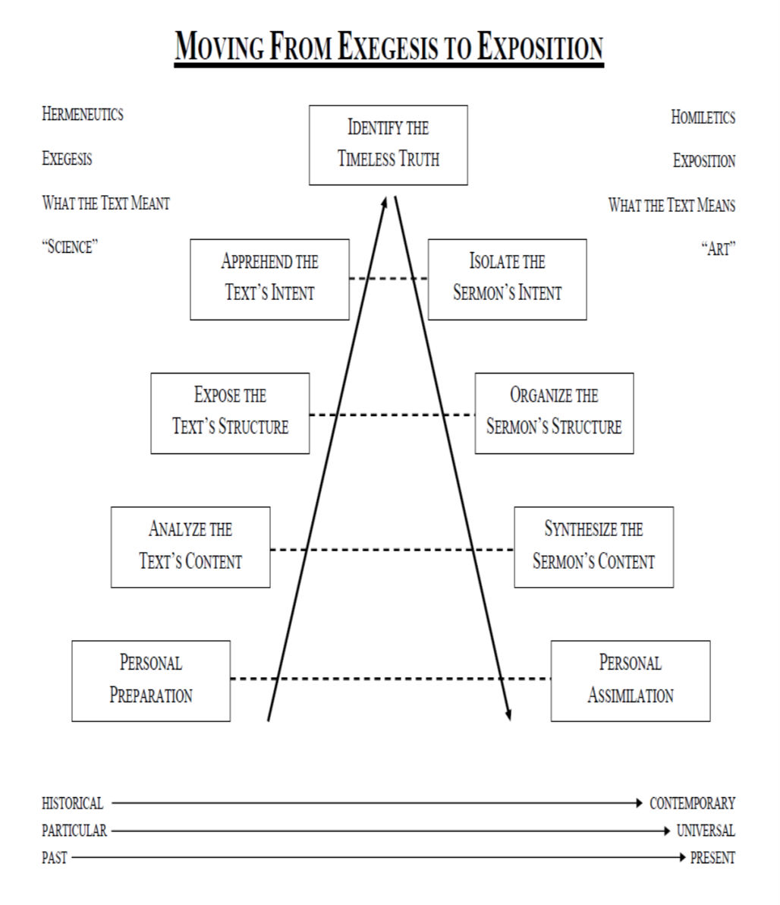

Slide 44

Developing a Rhythm of Sermon Preparation
An Ideal Week
Sunday: Contemplation + Compilation
Monday: Observations + Translations
Tuesday: Analyzations
Wednesday: Organization
Thursday: Publication-for-Communication
Friday: Saturation + Memorization
Saturday: Saturation + Memorization + Dedication

Slide 45
Exhortations for the Preacher
Preach the Word Conscientiously
Preach the Word Continuously
Preach the Word Comprehensively
Preach the Word Courageously

Slide 46
Parting Exhortation
Every Week
Read Yourself Full: John 5:39
Write Yourself Clear: 2 Timothy 2:15c
Pray Yourself Hot: James 5:13-16
Preach Yourself Empty: Acts 20:25-28*

Slide 47




$20 Separately and $60 as a Set
Homiletical & Devotional Resources
$ReginaldDTaylor

Slide 48

Spiritual Growth ResourceS
Spiritual Growth 101
Maintaining A Biblical Perspective During A Bad Pandemic
40 Sermons for $20
101 Sermons for $50
$ReginaldDTaylor

Slide 49



