Slide 1
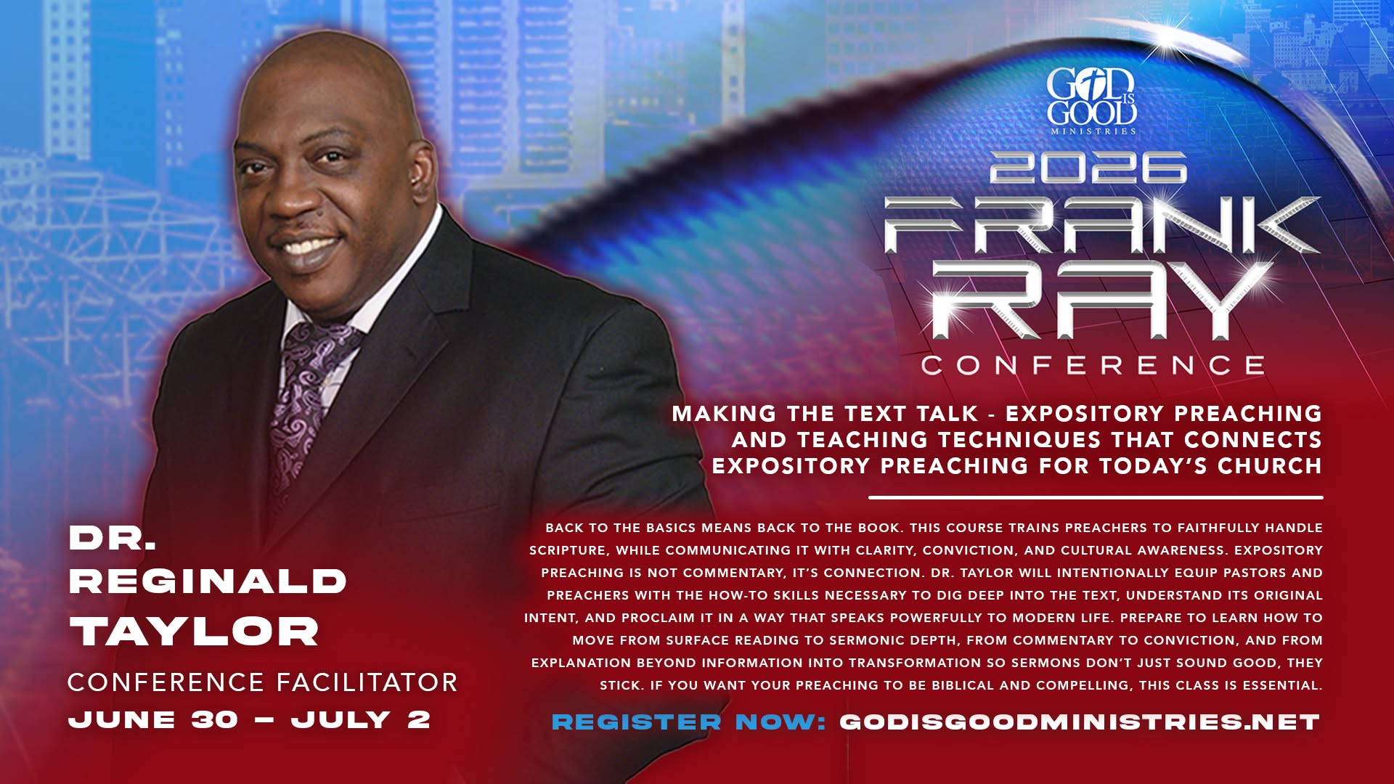


Slide 2

Making the Text Talk
Frank Ray Conference Teaching Plan
Day ❶ = Thinking Holistically as an
Expository Preacher
Day ❷ = Thinking Hermeneutically for
Expository Preaching
Day ❸ = Thinking Homiletically towards
Expository Preaching
Pastor Reginald D. Taylor 901-258-2876
reginaldtaylorministries@gmail.com

Slide 3
Making the Text Talk
Frank Ray Conference Teaching Plan
Day ❶ = Some Foundations for Exposition
Day ❷ = Some Functions for Exposition
Day ❸ = Some Flows for Exposition
Pastor Reginald D. Taylor 901-258-2876
reginaldtaylorministries@gmail.com

Slide 4
Making the Text Talk
Frank Ray Conference Teaching Plan
Day ❶ = Our Posture—the Heart
Day ❷ = Our Preparation—the Habits
Day ❸ = Our Preaching—the Heralding
Pastor Reginald D. Taylor 901-258-2876
reginaldtaylorministries@gmail.com

Slide 5
Making the Text Talk
Frank Ray Conference Teaching Plan
Day ❶ = Devotional
Day ❷ = Technical
Day ❸ = Practical
Pastor Reginald D. Taylor 901-258-2876
reginaldtaylorministries@gmail.com

Slide 6

Thinking Hermeneutically
A Seven Step Process for
Sermon Preparation
Pastor Reginald D. Taylor, Instructor
901-258-2876
reginaldtaylorministries@gmail.com

Slide 7

  Joshua 1:8 (KJV)
  ⁸ This book of the law shall not depart out of thy mouth; but thou shalt meditate therein day and night, that thou mayest observe to do according to all that is written therein: for then thou shalt make thy way prosperous, and then thou shalt have good success.
  Give Yourself to Revelation
  Give Yourself to Proclamation
  Give Yourself to Meditation
  Give Yourself to Observation
  Give Yourself to Application

Slide 8
  Colossians 3:16-17 (KJV)
  ¹⁶ Let the word of Christ dwell in you richly in all wisdom; teaching and admonishing one another in psalms and hymns and spiritual songs, singing with grace in your hearts to the Lord. ¹⁷ And whatsoever ye do in word or deed, do all in the name of the Lord Jesus, giving thanks to God and the Father by him.
  Saturation with the Word
  Edification with the Word
  Adoration from the Word
  Operation by the Word
  Magnification through the Word
  Appreciation according to the Word

Slide 9
A. Louise Patterson Principle
“Letting the text tailor the truth you’re trying to teach”
2 Timothy 2:15
  Be Studious in the Word
  Be Stable in the Worship
  Be Steadfast in the Work
  Be Standardized in the Way of Interpretation

Slide 10

“Expository preaching is the Spirit-empowered explanation and proclamation of the text of God’s Word with due regard to the historical, contextual, grammatical and doctrinal significance of the given passage, with the specific object of invoking a Christ-transforming response.”
2 Timothy 3:16-17
Mind-Morals-Mistakes-Maintenance
Make-Up-Maturity-Ministry

Slide 11
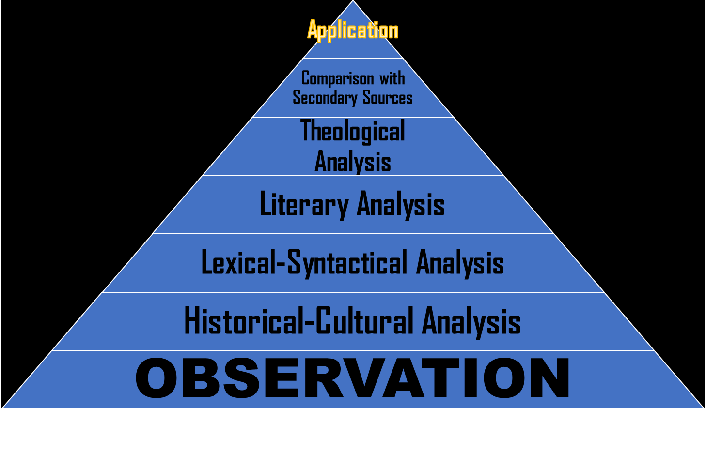

Slide 12

Reading
Reflecting
Recording
 OBSERVATION
Probing
Pondering
Printing
 OBSERVATION
OBSERVATION
Investigating, Meditating, Annotating

Slide 13
Read Thoughtfully (Phil. 4:8-9)
Read Repeatedly (Ps. 119:97-104)
Read Patiently (Rom. 15:4)
Read Selectively (Mark 2:1-12)
Read Prayerfully (Ps. 119:17-19)
Read Imaginatively (Ps. 139:1-18)
Read Meditatively (Joshua 1:8)
Read Purposefully (Ps. 119:33-40)
Read Acquisitively (Ps. 119:9-16)
Read Telescopically (II. Tim. 3:16-17)
The Preacher & His Soul

Slide 14
THINGS TO LOOK FOR
A serious reading of the Bible requires the student to read the text over and over and to pay attention to the details of the text.
Repetition of words describes words that are repeated within a given passage.
Contrasts focus on differences between items, ideas, and individuals.
Comparisons focus on similarities between items, ideas, and individuals.
Lists are comprised of more than two itemized things.

Slide 15
THINGS TO LOOK FOR
Cause and effect describes a relationship within a passage of Scripture.
Figures of speech are images in which words are used in a sense other than the normal, literal sense.
Conjunctions hold together sentences and phrases. It is necessary to determine the function of each conjunction.
Verbs communicate the action of a sentence. It is necessary to determine the tense and voice of each verb.
Pronouns are words that take the place of nouns. It is necessary to determine the antecedent of each pronoun.

Slide 16
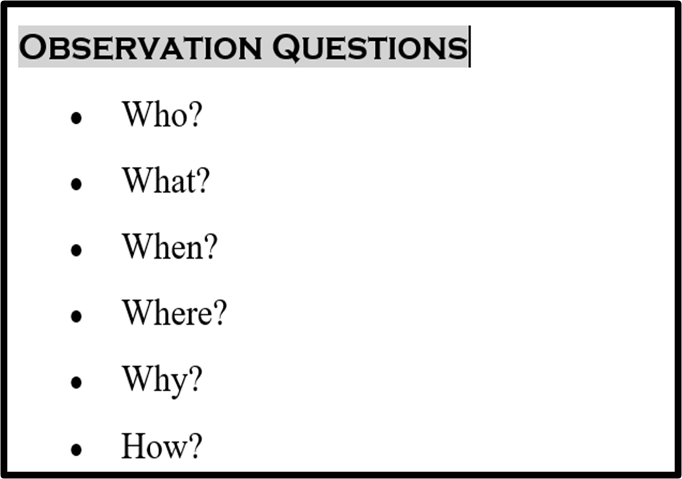
I had six faithful friends,
They taught me all I knew,
Their names are How and What and Why,
When and Where and Who.
Interrogate the TEXT

Slide 17
Bible Interpretation Pyramid

Slide 18

Dr. Haddon Robinson
Historical-Cultural Analysis
“Expository preaching is the communication of a biblical concept, derived from and transmitted through a historical, grammatical, and literary study of a passage in its context, which the Holy Spirit first applies to the personality and experience of the preacher, then through the preacher, applies to the hearers.”
Luke 15:1-32

Slide 19
Meaning in the Moment
Historical-Cultural Analysis
History = Periods
Culture = People
History = The When
Culture = The Ways
History = The Moment in History
Culture = The Mores of Humans
Ruth 1:1 & Judges 21:25
2 Sam. 11:1 = David’s Downfall
Matt. 4:18-19

Slide 20
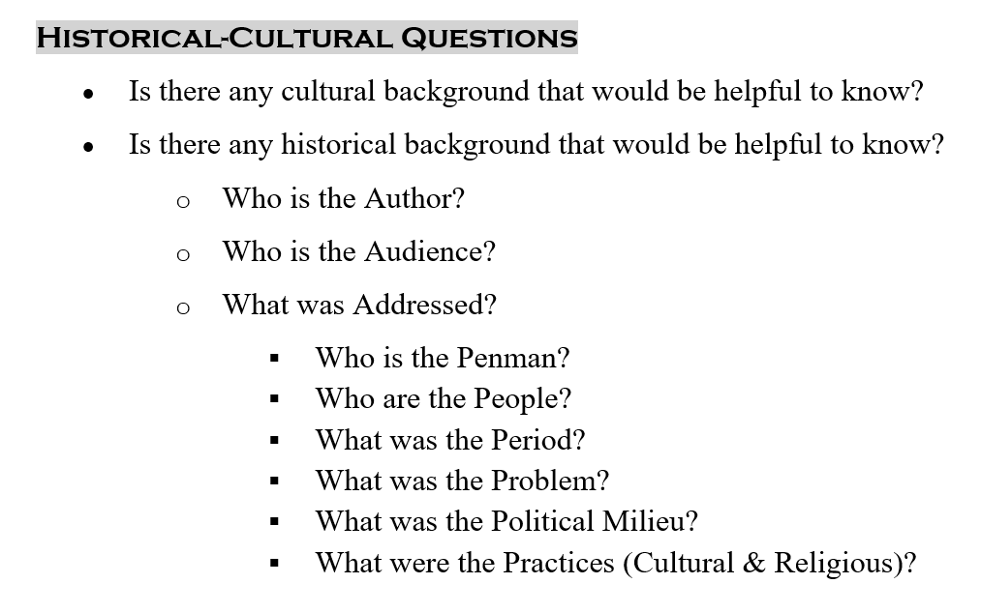
Interrogate the Text

Slide 21
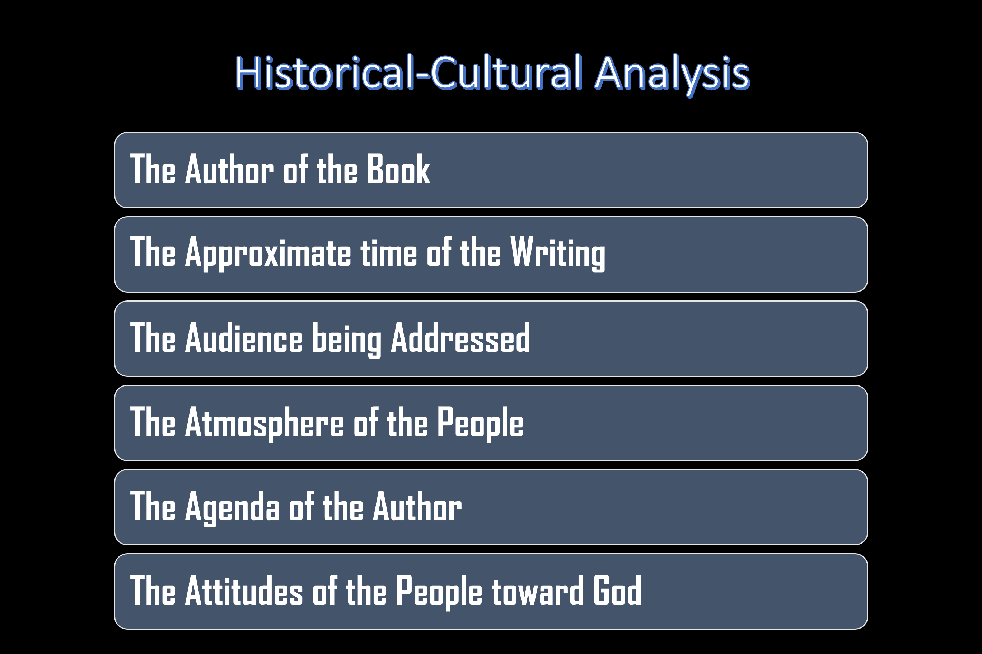
Interrogate the Text
Historical-Cultural Analysis

Slide 22
Tools for Historical-Cultural Analysis
Study Bibles (Multiple)
The Cambridge Companion to the Bible 2007
Manners and Customs of the Bible by James M. Freeman | Mar 1, 1996
Illustrated Manners and Customs of the Bible by J. I. Packer and Merrill C. Tenney 2003←
Zondervan Illustrated Bible Backgrounds Commentary Set
Bible Surveys/Introductions
Bible Dictionaries

Slide 23
Bible Interpretation Pyramid

Slide 24
Lexical-Syntactical Analysis
Lexical-Syntactical Questions
What are the significant words in this passage?
What is the meaning of this word in its original language?
How can I properly understand this word in light of its context?
Does the original language give any pictures or illustrations that help me understand the word better? (i.e.: The Greek word baptizō – baptism – gives the picture of a cucumber being immersed in the vinegar solution and turning into a pickle)

Slide 25
Lexical-Syntactical Analysis
Lexical-Syntactical Questions
What are the significant words in this passage?
What is the meaning of this word in its original language?
How can I properly understand this word in light of its context?
Does the original language give any pictures or illustrations that help me understand the word better? (i.e.: The Greek word baptizō – baptism – gives the picture of a cucumber being immersed in the vinegar solution and turning into a pickle)

Slide 26
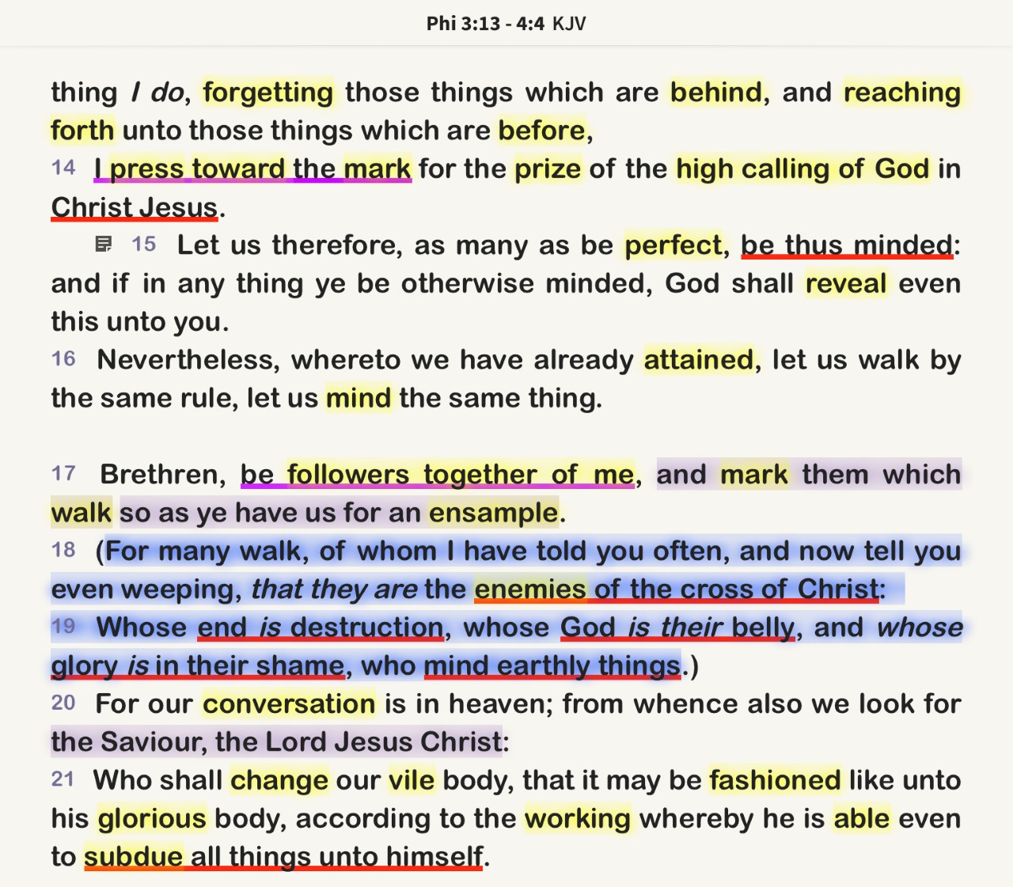
Word-Study Example

Slide 27
Lexical-Syntacticle Analysis
Grammatical Considerations (under Lexical-syntactical analysis)
  What can the grammar of the passage tell us? (i.e.: examine each word and its contribution to the whole — nouns, verbs, adjectives, adverbs, direct objects, etc.)
  Should I diagram this passage? (remember 6th grade sentence diagraming? Sometimes this can help see how a passage breaks into its pieces)

Slide 28
Lexical-Syntacticle Analysis
Sentence Considerations (under Lexical-syntactical analysis)
What are the key words in this sentence? Should I do a word study on them?
Is there any repetition of words, phrases, concepts? (repetition often shows importance) (i.e.: God is holy, holy, holy)
Is there a contrast? (things that are different)
Is there a comparison? (things that are alike)
Is there a list given?
Is there a cause and effect? (note: sometimes the effect is given before the cause)
Is there a conjunction? (i.e.: and, but, for, therefore, since, because …)
What is the main verb?
Who is the subject of the sentence?

Slide 29
Lexical-Syntacticle Analysis
Sentence Considerations (under Lexical-syntactical analysis)
If there are pronouns, who do they refer to? (i.e.: he, she, them, they, you, me, etc.)
Are there any figures of speech or idioms?
English Examples: it’s raining cats and dogs, he’s in a jam, underdog …
Bible Examples: lamp unto my feet, harden your hearts, white-washed tombs, a double-edged sword

Slide 30
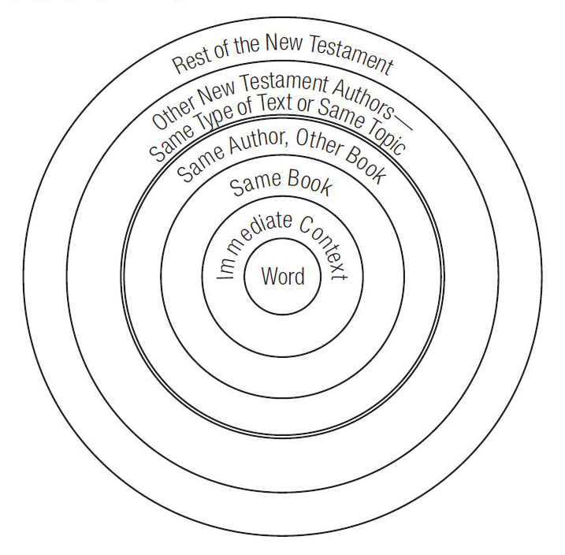
Lexical-Syntactical Analysis
➊ Determine the Significant Words
➋ Define the Significant Words
➌ Distinguish the Significant Words

Slide 31

Resources for Lexical-Syntactical Analysis
The Complete Word Study Bible and Dictionary Pack (5 Volumes)
Notes:
Be Studious, Stable, Steadfast, & Standardized Outline
The Imperative to Study
The Importance of Study
The Implications of Study
2 Tim. 3:16-4:2 = The 7M’s
Matt. 4:1-11 = Worldview, Warfare, Worship
2 Tim. 2:1-2 = Scholarship for Discipleship

Slide 32
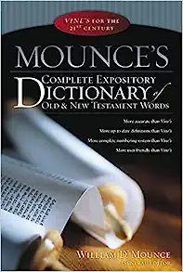
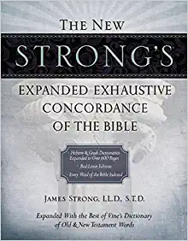
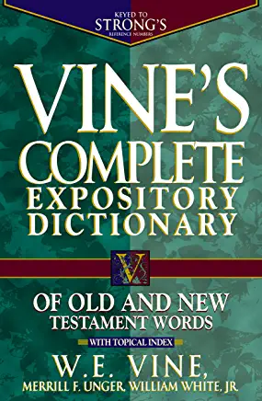
Resources for Lexical-Syntactical Analysis
Notes:
Be Studious, Stable, Steadfast, & Standardized Outline
The Imperative to Study
The Importance of Study
The Implications of Study
2 Tim. 3:16-4:2 = The 7M’s
Matt. 4:1-11 = Worldview, Warfare, Worship
2 Tim. 2:1-2 = Scholarship for Discipleship

Slide 33
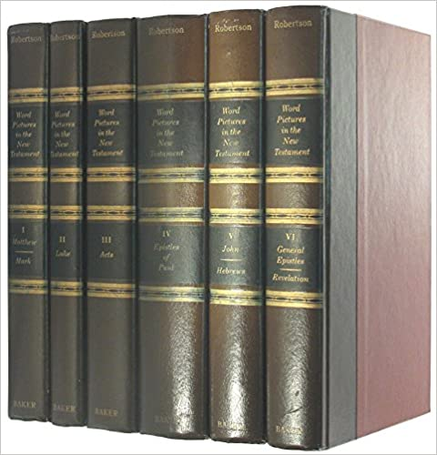
Resources for Lexical-Syntactical Analysis
Word Pictures in the New Testament 6-Vol. Set
Notes:
Be Studious, Stable, Steadfast, & Standardized Outline
The Imperative to Study
The Importance of Study
The Implications of Study
2 Tim. 3:16-4:2 = The 7M’s
Matt. 4:1-11 = Worldview, Warfare, Worship
2 Tim. 2:1-2 = Scholarship for Discipleship

Slide 34
Bible Interpretation Pyramid

Slide 35
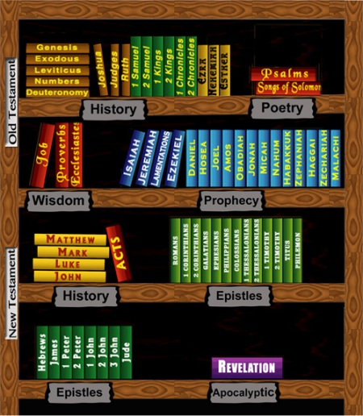
Literary Analysis
➊ Determine the Type of Literature
➋ Define the Type of Literature
➌ Distinguish the Type of Literature

Slide 36
Literary Analysis
➊ Determine the Type of Literature
➋ Define the Type of Literature
➌ Distinguish the Type of Literature

Slide 37
The Voice of God in the Word of God
Story
Poem
Letter
Literary Analysis
OT Narrative
Psalms
Epistles
Law
Prophecy
Revelation
Gospels
Acts
Wisdom Literatur
Parables
Job, Prov, Eccless,SOS

Slide 38
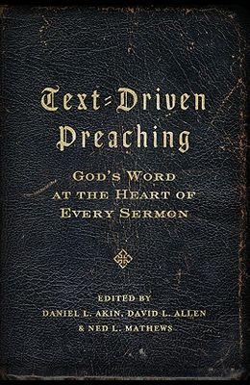
Literary Analysis
A text-driven sermon is a sermon that develops a text by explaining, illustrating, and applying its meaning. Text-driven preaching stays true to the substance of the text, the structure of the text, and the spirit of the text.

Slide 39
Literary Analysis
Literary Analysis Questions
What type of Literature is this passage? (STORY = OT Narrative, Law, Acts/Gospels⇨Parables. POETRY = Psalms, Prophecy, Wisdom Literature ⇨ Job, Proverbs, Ecclesiastes, Song of Solomon. LETTER = NT Epistles, Revelation
How should I read this genre or type of literature? (Figuratively or Literally)

Slide 40


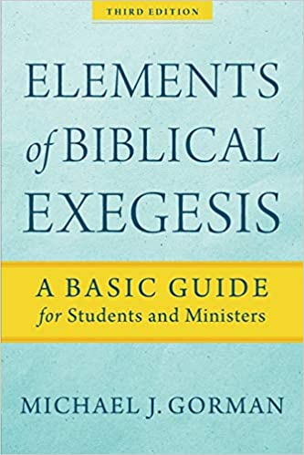
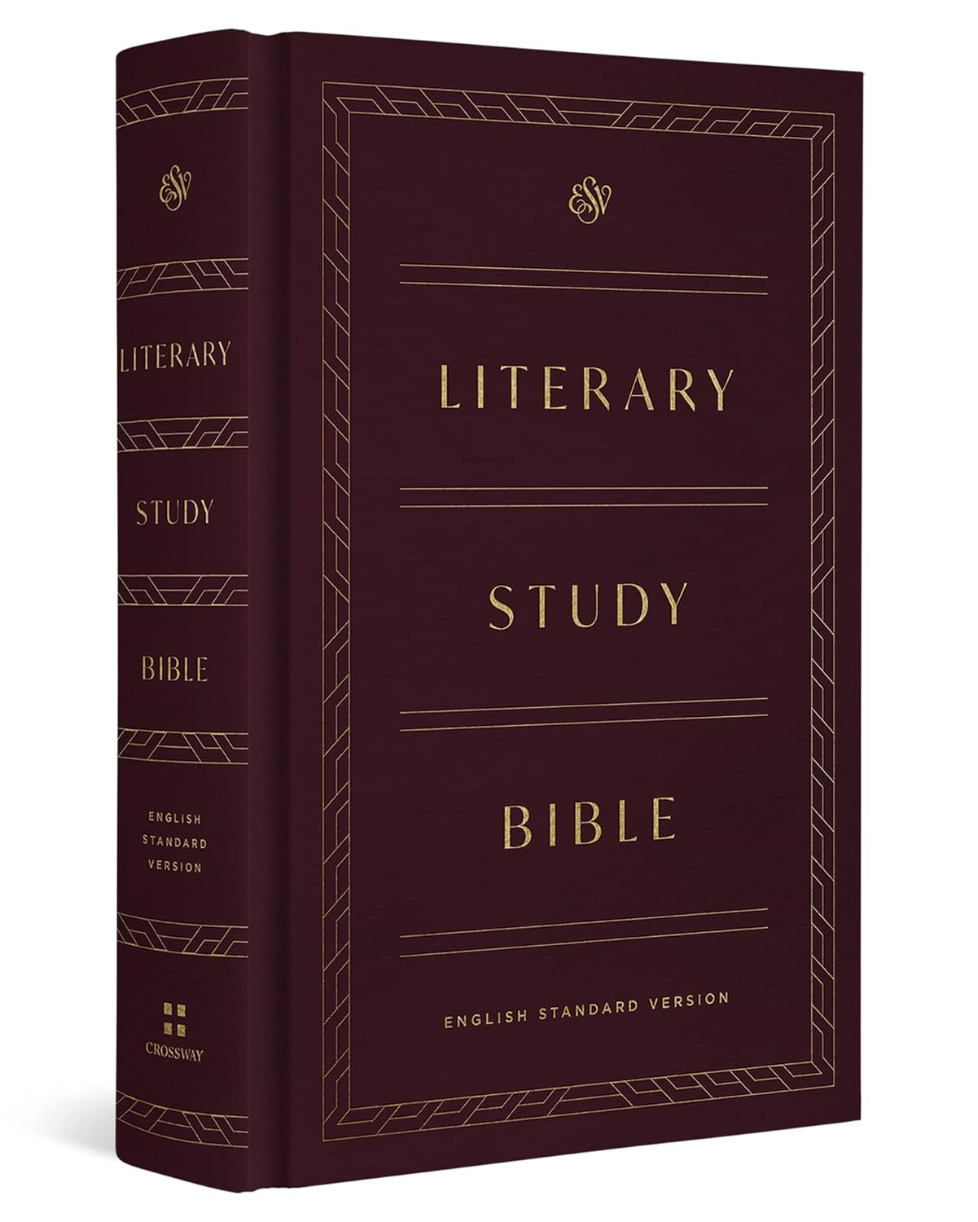
Tools for Literary Analysis

Slide 41

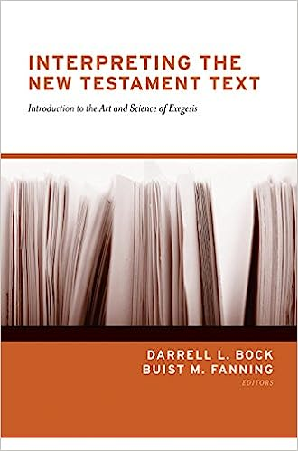

Tools for Literary Analysis

Slide 42



Tools for Literary Analysis

Slide 43
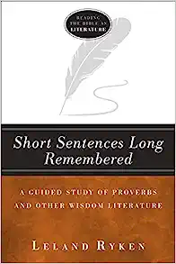
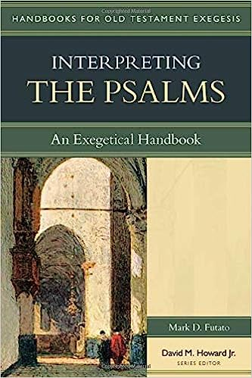

Tools for Literary Analysis

Slide 44
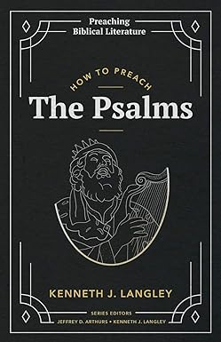
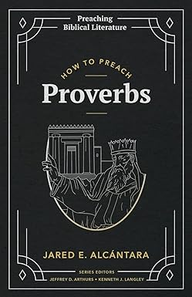
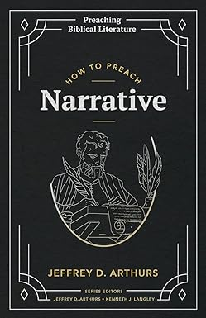
Tools for Literary Analysis

Slide 45
Bible Interpretation Pyramid

Slide 46
Theological Analysis
Reading the Bible Theologically
Reading the Bible Theologically
To read the Bible “theologically” means to read the Bible “with a focus on God”: his being, his character, his words and works, his purpose, presence, power, promises, and precepts. The Bible can be read from different standpoints and with different centers of interest, but theological analysis requires reasoning about God.

Slide 47
Theological Analysis
Theologically Examining the Text
Theological Analysis Questions (Theological)
  What did the author/audience know about God?
  What did the author/audience know about Jesus Christ?

Slide 48
Theological Analysis
Reading the Text Theologically
Theological Analysis Questions (Devotional)
What does this passage teach me about God?
What does this passage teach me about Jesus Christ?
What does this passage teach me about the Holy Spirit?
What does this passage teach me about human nature (all people)?
What does this passage teach me about me?

Slide 49

Theological Analysis
Theological Analysis Questions
Old Testament Questions
How does this Old Testament passage reveal Jesus Christ?
How does the passage/concept find its fulfillment in the New Testament?

Slide 50
Theological Analysis
Eph. 4:8-16/Ps. 68:18
Theological Analysis Questions
New Testament Questions
  Does this New Testament passage or verse show up in the Old Testament? If so, how does the original context give insight into the New Testament passage?
  Can this New Testament passage be illustrated from the Old Testament? If so, how?
2 Cor. 12:7-10
2 Chron. 20:1-20

Slide 51
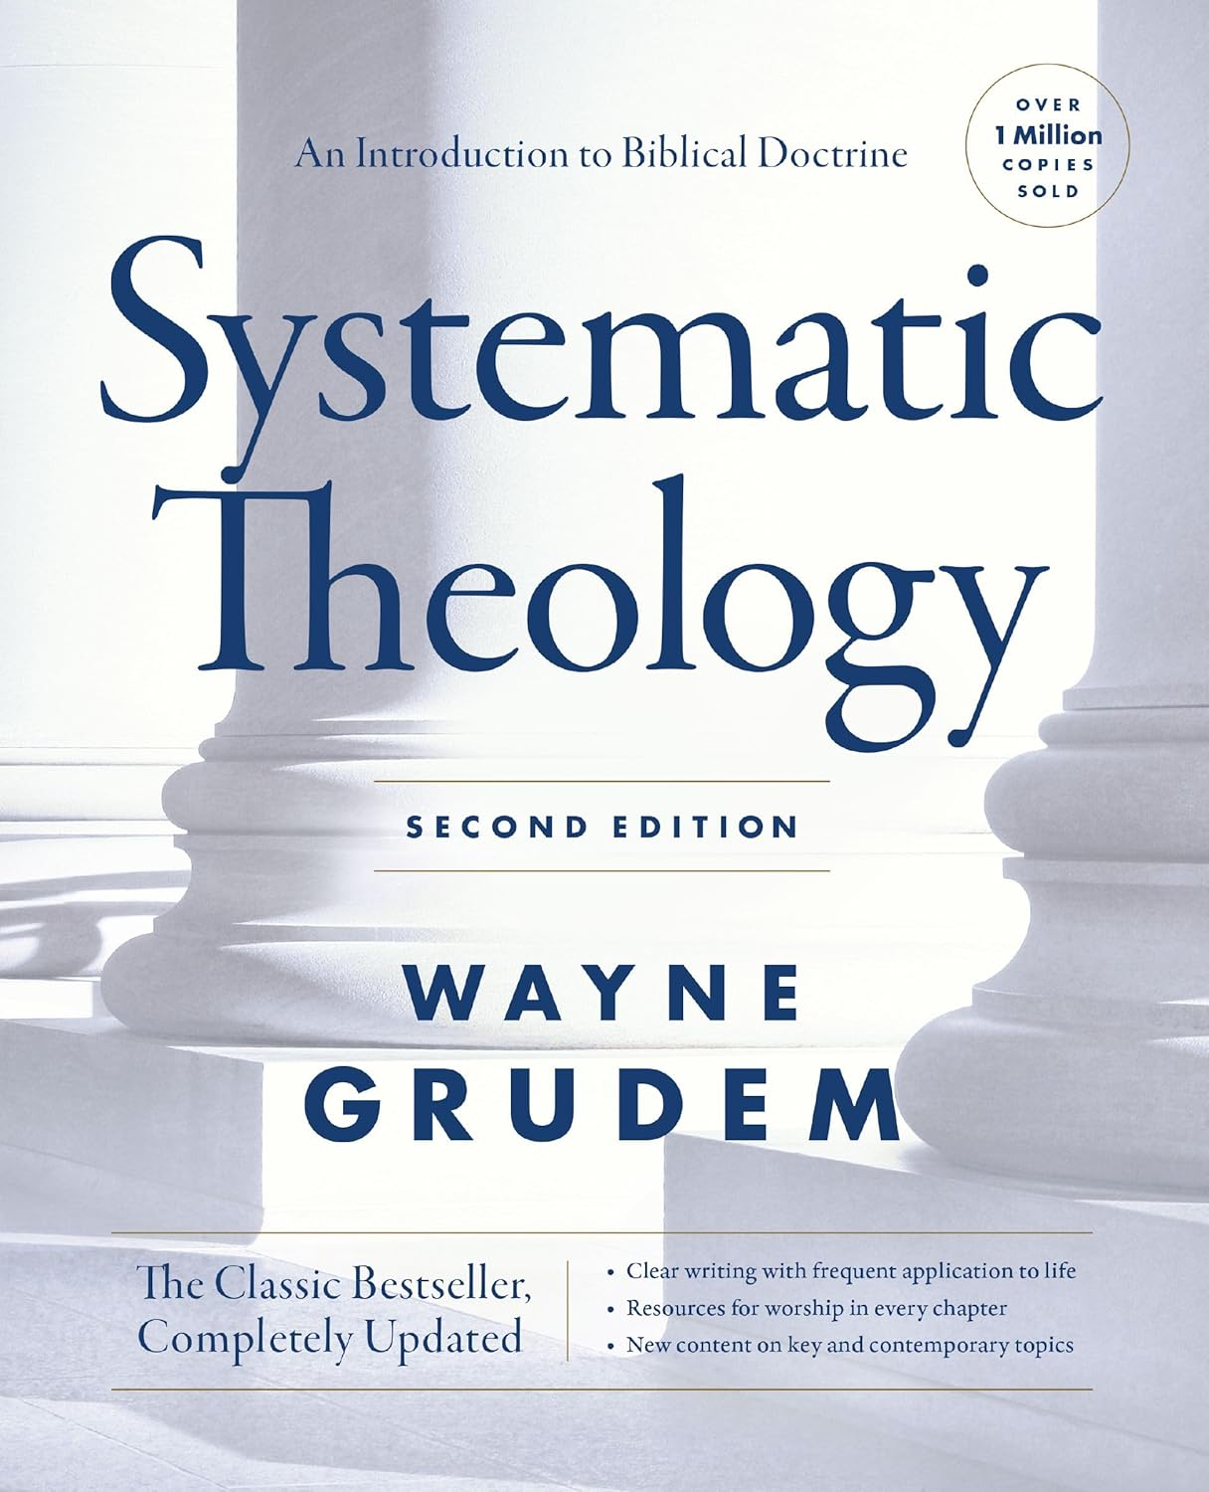

Tools for Theological Analysis

Slide 52


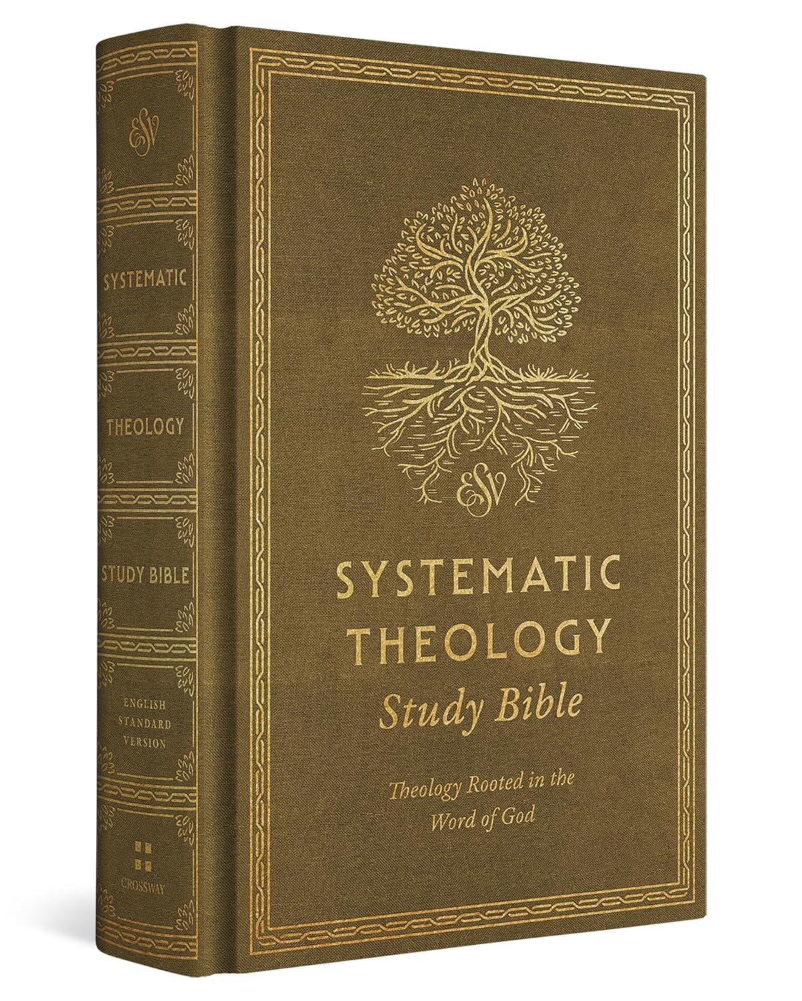
Tools for Theological Analysis

Slide 53

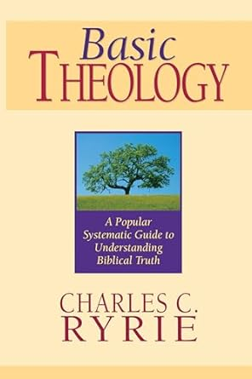
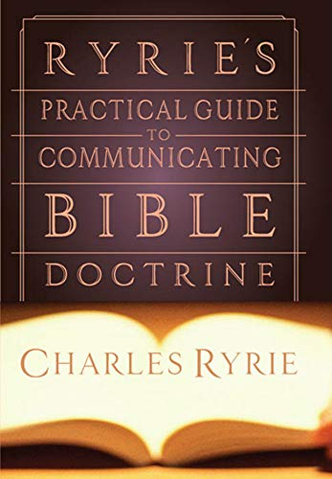
Tools for Theological Analysis

Slide 54
Bible Interpretation Pyramid

Slide 55
Comparison with Secondary Sources
Comparison with Secondary Sources Questions
Who are the best writers on this Bible book?
Do I need to consult an analytical (or exegetical), devotional, or homiletical commentary?
What does other commentators say about the passage?
How does their comments differ from my discoveries or ideas?
What have I read that challenges my ideas about the passage?
What have I read that changes my ideas about the passage?
What have I read that confirms my ideas about the passage?

Slide 56
Comparison with Secondary Sources
Figures in Church History to Read if Time Allows
John Chrysostom, Augustine of Hippo, Origin, Martin Luther, John Calvin, Puritan Preachers, John Wesley, Charles Spurgeon, Martyn Lloyd-Jones, John Stott

Slide 57
Why Christians Should Use Commentaries
Use Commentaries for Appropriate Tasks
Commentaries vary in size, detail, level, and theological basis; they also have different roles in the exegetical process. The following classification is partly chronological – the first books are used earlier in the process than the latter books. (The books in brackets are OT focused and are merely exemplary not exhaustive).

Slide 58
Types of Commentaries
Critical: Emphasis on technical matters like the composition of the text rather than its meaning (e.g. International Critical Commentary, some Word commentaries). PROBLEMS
Expository (Original Language): Close and detailed exposition of the text, usually requiring some knowledge of the original languages (e.g. some Word commentaries, New International Commentary on the OT, Expositor’s Bible Commentary, Mentor series by Christian Focus). PRECISENESS

Slide 59
Types of Commentaries
Expository (English): Stay close to the text but do not usually deal with critical issues and do not require original language knowledge (Focus on the Bible series by Christian Focus, Evangelical Press Study Commentaries). PORTRAITS
Summary: Do not explain everything but focus on main points and present conclusions rather than extensive arguments. Excellent summaries of a verse or passage’s teaching. Big is not always better. (e.g. Tyndale Old Testament Commentaries, Bible Speaks Today). POINTS

Slide 60
Types of Commentaries
Classical: Reputable commentaries from the past that usually do not deal with technical issues, but rather the theological meaning of the text (Banner of Truth Geneva series, John Gill, John Calvin). PREMISES
Applicatory: Suitable for lay-people, usually with more of an applicatory focus (NIV Application Commentary). PRACTICAL

Slide 61
Types of Commentaries
Homiletical: Tend to be the result of sermon series or at least more sermonic in style (e.g. Welwyn, Dale Ralph Davis). PREACHING
Devotional: Extensive comments on spiritually rich texts. Focus on edification rather than critical or controversial issues (e.g. Matthew Henry). PERSONAL-RELATIONSHIP

Slide 62
Types of Commentaries
Use Recommended Commentaries
Ask pastors and professors for their recommendations on various books & Check Bibliographies & Footnotes. Weigh the recommendations. Just because a Word series’ commentary on one book is good does not guarantee that they are all good.
Spurgeon: “The best commentators are those who have written upon only one book. Few men can comment eminently well upon the whole Bible.”

Slide 63
Types of Commentaries
There are many OT commentary guide books (e.g. Tremper Longman III, Douglas Stuart, Charles Spurgeon, etc). Here are some online recommendations:
Joel Beeke’s best Commentaries
Best Commentaries
Best Commentaries: Top 2 for each book
Ligonier: Top 5 Commentaries on every book of the Bible
Desiring God recommendations
Tim Challies Top 5 Commentaries
Bestcommentaries.com

Slide 64
How to Use Commentaries
Use them late in exegesis
If you use commentaries too early, they will take over and suppress your own thought. Do your own exegesis rather than collate the work of others.
Use them to get started in exegesis
This may seem like a contradiction to #4, but what I mean is that you should use commentaries earlier in the process if you get stuck, or perhaps can’t even get started. They can provide helpful or even essential historical, geographical, or cultural background. Look for Problems, Purposes, & Pathways

Slide 65
How to Use Commentaries
Use them to confirm or correct your pericope and translation
Checking your pericope selection and your translation with a higher-end commentary before you begin your exegesis may save you a lot of time and energy. The Unit of Thought & Meaning of Words
Use them to confirm or correct your exegesis
If after exegeting a passage you find a number of commentators contradicting your conclusions, then review your work and decide who is correct. Converse, Compare, & Correct

Slide 66
How to Use Commentaries
Use them to help you understand grammar and syntax
Some of the more technical commentaries can help you translate difficult parts of the passage, or perhaps highlight grammatical and syntax issues that help to uncover a text’s meaning and message. Discovering Meaning through STRUCTURE
Use them to highlight unasked questions
When I read a commentary I often find questions raised that I had not even considered, forcing me back to the text. Expanding Exploration

Slide 67
How to Use Commentaries
Use them to answer unanswered questions
It may be that at the end of all your exegetical labor that you still don’t have an answer to a question. That’s when reading a number of commentaries can help you better understand the options and arguments and help you to come to a decision. Discovery & Decision-Making
Use them to help you decide what to focus on
Reading a commentary may reveal that what you thought important is relatively unimportant, and may also point you to study further in areas that you thought unimportant. Identifying Significant Substance

Slide 68
How to Use Commentaries
Use them to find opposing arguments and conclusions
As it’s often helpful to listen to the other side of an interpretive debate, make sure you consult commentators who state the other positions fairly, or best of all, read the opposing commentators to help you sharpen your own conclusions or change them. Awareness & Apologetics
Use them to get quotes to back up conclusions
If your view is out of sync with the majority of commentators, or if it is controversial, it is often helpful to back up your argument and decision with a quote from a reliable commentator. Explanation & Argumentation

Slide 69
How to Use Commentaries
Use them to help you express the meaning
Especially if you’ve been struggling to express your thoughts, commentators can provide you with words that more briefly or clearly express the same thing. Clarity in Communication
Use them by translating their thoughts into your own words
Don’t just string quotes from various commentators together. If you are going to use them extensively, then at the very least, process their thoughts and translate them into your own words, while giving credit for the original thoughts. Integrity & Creativity for Credibility & Clarity

Slide 70
How to Use Commentaries
Use them consistently
If you adopt a conclusion from a commentator, make sure it is reflected in the rest of your work. Go back through and be consistent in your translation or interpretation of a word or phrase. Start, Stick, Stand, & Stop with the WORD
Use them discriminately
Eventually you will get to know the particular theological biases and prejudices in certain commentaries and certain series. As long as you keep these in mind, you can filter out the bones and take the meat. Separate facts from opinion. Take-in & Put-out the Good, but Break-Away from the Bad

Slide 71
How to Use Commentaries
Use them independently
Don’t become wholly dependent upon commentaries; not even upon one commentator or series of commentaries. We don’t want to belittle commentaries but we don’t want to be bullied by them either. Have confidence in your own prayerful Spirit-led exegesis. Trust the Holy Spirit—John 14:26; 1 John 2:27

Slide 72
Bible Interpretation Pyramid

Slide 73
Application
Defining Application
Application is putting into practice what we already know (see Mark 4:24 and Hebrews 5:14) and answering the question, “So what?” by confronting us with the right questions and motivating us to take action (see 1 John 2:5, 6 and James 2:17). Applying the Bible is deeply personal—unique for each individual. It is making a relevant truth a personal truth, and involves developing a strategy and action plan to live your life in harmony with the Bible. It is the Biblical “how to” of life.

Slide 74
Application
Defining Application
In Bible study, application is putting truth you've discovered (through observation and interpretation) to use in your life with the ultimate goal of transformation or life change. Bible study is meant not merely to inform but to transform and renew our mind.
Romans 12:1-2; Heb. 5:11-14

Slide 75
Application
Defining Application
Application takes place as you are confronted with the truth and you respond to that truth in obedience (in faith).
Application begins with belief
which then results in being and doing.
John 15:1-8

Slide 76
Application
Defining Application
Be alert for the following deceptive dangers regarding application
(1) Substituting interpretation for application as did the Pharisees;
(2) Substituting superficial obedience for substantial life-change
(3) Substituting rationalization for repentance.
I. John 1:7

Slide 77
Application
Application Questions
1. S – Is there a Sin to avoid, forsake or confess?
2. P – Is there a Promise to believe or condition to meet in order to partake of the promise?
3. A – Is there an Attitude to change/guard against or an Action I need to take?
4. C – Is there a Command to keep?
5. E – Is there an Example to follow?
6. P – Is there a Prayer to pray or a Priority to change?
7. E – Is there an Error to mark?
8. T – Is there a Truth to memorize and meditate upon?
9. S – Is there Something to thank or praise God for?

Slide 78

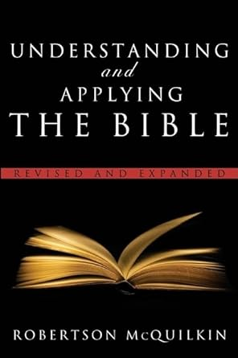
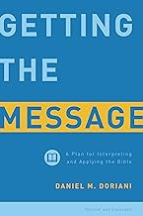
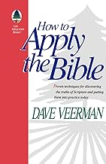
Resources for Application

Slide 79
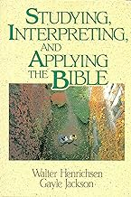
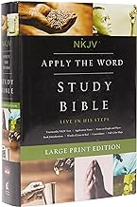

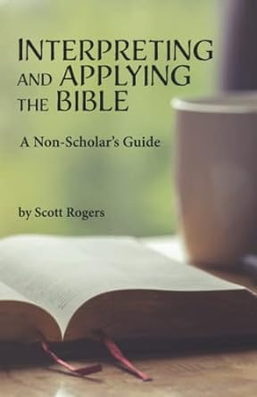
Resources for Application

Slide 80
Exhortations for the Preacher
Preach the Word Conscientiously
Preach the Word Continuously
Preach the Word Comprehensively
Preach the Word Courageously

Slide 81
Parting Exhortation
Every Week
Read Yourself Full: John 5:39
Write Yourself Clear: 2 Timothy 2:15c
Pray Yourself Hot: James 5:13-16
Preach Yourself Empty: Acts 20:25-28*

Slide 82




$20 Separately and $60 as a Set
Homiletical & Devotional Resources
$ReginaldDTaylor

Slide 83

Spiritual Growth ResourceS
Spiritual Growth 101
Maintaining A Biblical Perspective During A Bad Pandemic
40 Sermons for $20
101 Sermons for $50
$ReginaldDTaylor

Slide 84



